Slide 1


Slide 2
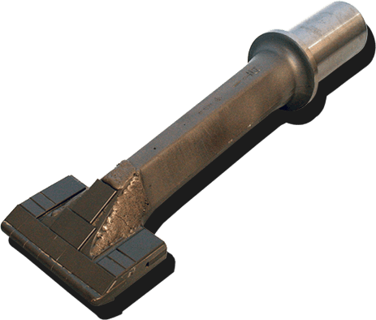
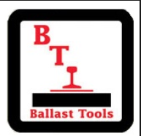
BTI Tamping Tynes: Effective Tamping Time After Tine

Slide 3
BTI -THE TAMPING TYNE SPECIALISTS
BTI are the worldwide specialist manufacturer of tamping tynes
BTI are known globally for their unmatched quality, performance and long life tamping tynes.
BTI have been researching and manufacturing quality tynes for over 35 years. They are leaders in tamping tyne performance improvement and innovation.
BTI are the leader in tungsten carbide wear parts for railroad Maintenance of Way equipment

Slide 4
BTI AND KEY SOURCE RAIL – PARTNERED SUCCESS
Key Source Rail provides 95% of the BTI product Australia wide
Key Source Rail understands the BTI product
Key Source Rail has extensive tamping tool and track machine experience (combined in-house knowledge in excess of 120 years)
Key Source Rail have partnered with BTI for in excess of 15 years

Slide 5
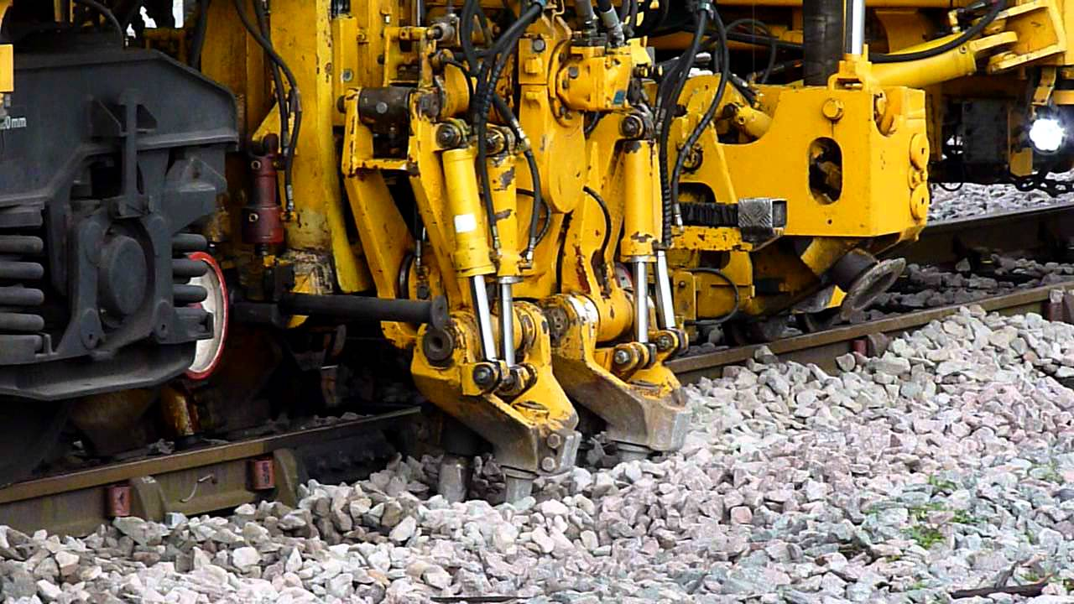
Key Source Rail Tamping Tyne Study

Slide 6
The Importance of Managing Tyne Wear
There is a direct correlation between tyne wear and:
Loss of Squeeze Effectiveness and
Loss of Consolidation Effectiveness
This leads to:
Increased tamping time for less metreage of cover (double or triple squeeze)
Increased Operating Cost ($/ metreage of cover)
Increased Maintenance Cost ($/ metreage of cover)

Slide 7
ARTC Wear Recommendation
“Quality of Output - If a quality and long lasting output is not being achieved, the following possible causes should be investigated:
Worn tamping tools – a tamping tyne must be replaced when more than 20 – 25% of the tyne face area has worn away or broken off.
The lift on each pass is too great;
The basic lift is insufficient;
There is not enough depth of good quality ballast beneath the sleepers – track with poor drainage and/or fouled ballast will not compact properly;
Tamping depth is incorrect – if the depth is insufficient, ballast will be ineffectively pressed against the sides of the sleepers;
Tamping rate is too fast – if the squeeze time is too low, optimum ballast compaction may not be achieved; and
Incorrect calibration of tamper measuring or control systems”
Source : ARTC Mechanised Track Surfacing Procedure p 26 - see link
https://extranet.artc.com.au/docs/eng/track-civil/procedures/track-geo/pp-135.pdf

Slide 8
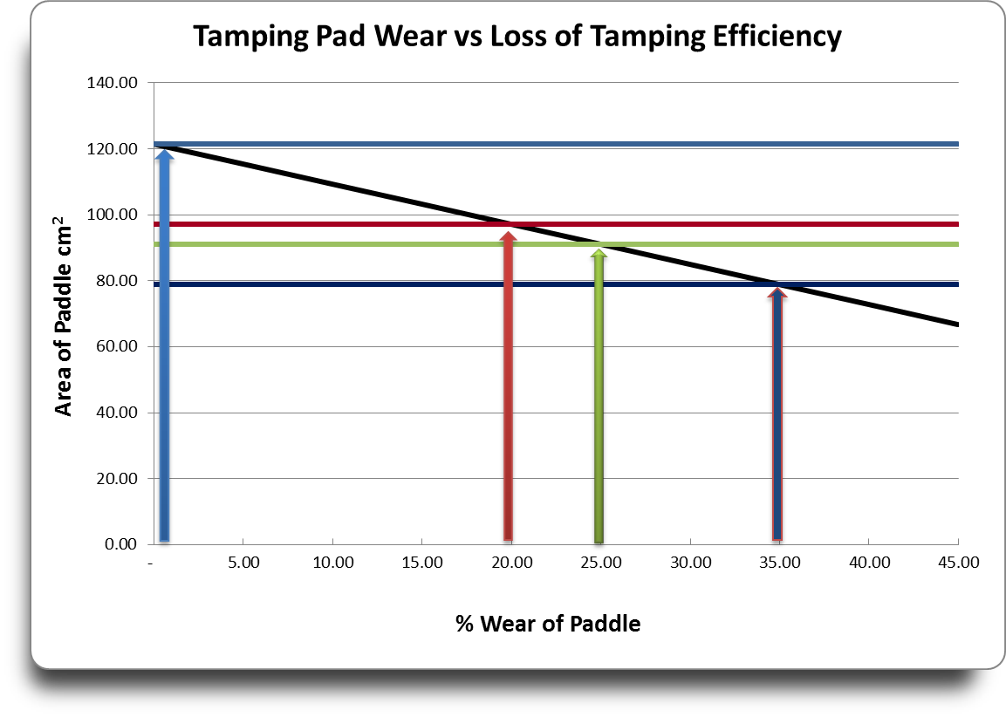
Key Source Rail Tamping Tyne Study

Slide 9
Key Source Rail Tamping Tyne Study

Slide 10
Key Source Rail Tamping Tyne Study
20% loss of tamping efficiency

Slide 11
Key Source Rail Tamping Tyne Study

Slide 12
Key Source Rail Tamping Tyne Study
25% loss of tamping efficiency

Slide 13
Key Source Rail Tamping Tyne Study

Slide 14
Key Source Rail Tamping Tyne Study
35% loss

Slide 15
Key Source Rail Tamping Tyne Study
Recommended Replacement
Tolerance

Slide 16
Wear and Loss of Effectiveness: 135 x 90 mm paddle
Recommended Replacement
Tolerance
Absolute Condemnation Point – further use will lead to significant economic loss

Slide 17
Key Source Rail Tamping tyne Study
Excessive wear on tamping tynes leads to:
Increased $/ metre tamping operating cost
Increased maintenance cost ($/metre)
Increased $/metre tamping tyne major component cost
Loss of effective tamping machine life
More insertions per metre for same result
Less squeeze effectiveness
Less compaction
Reduced track quality
Reduced safety – track compromise

Slide 18
Key Source Rail Tamping tyne Study
What does timely tyne replacement deliver?
Increased efficiency maintaining the under track condition
Improved maintenance cost per time spent tamping
Improved operating cost (labour and running cost) per time spent tamping
The same level of operating and maintenance cost delivers more and better quality tamping
Save on maintenance and operating costs and deliver more effective tamping by not allowing your tynes to wear beyond 20%.

Slide 19
FEATURES OF THE BTI TYNE

Slide 20
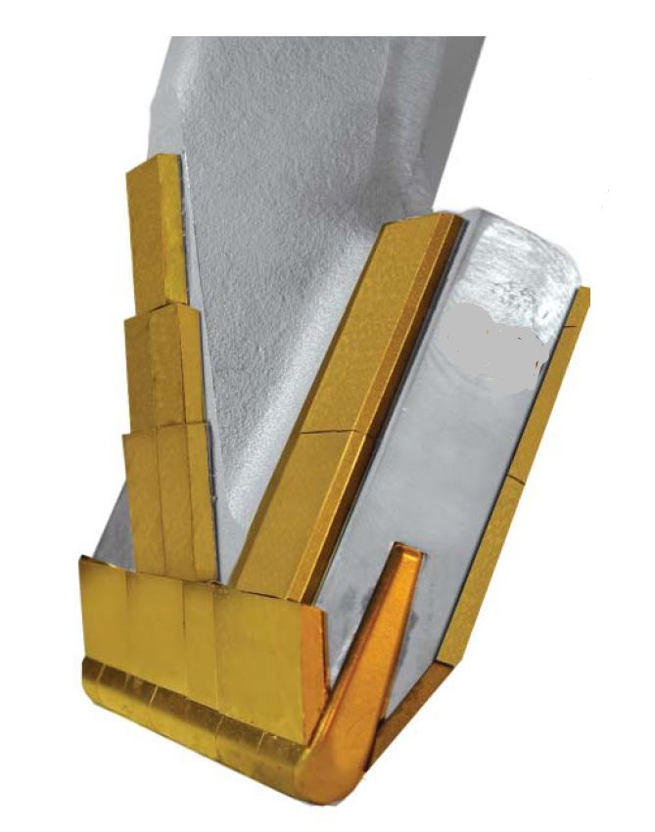
FEATURES OF THE BTI TYNE
1. Patented Wedge Design
The Wedge Design reduces the force needed to insert the tool and reduces the overall wear

Slide 21
FEATURES OF THE BTI tyne
2. Extreme Carbide Wedge Tip
The XTREME carbide tip reduces the amount of broken tips caused by impact with debris in the ballast.

Slide 22
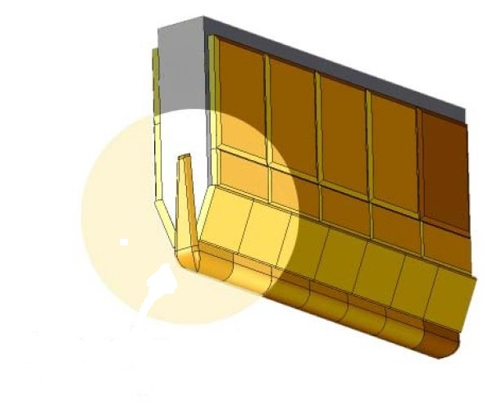
FEATURES OF THE BTI TYNE
2. Extreme Carbide Wedge Tip
Force from the impact of the tamper will direct the carbide tighter into the
tip, not away from it, resulting in fewer damaged tips.

Slide 23
FEATURES OF THE BTI TYNE
3. Shoulder Carbide Protection
The Carbide Shoulder Protection Insert ensures longer tyne life

Slide 24

FEATURES OF THE BTI TYNE
4. Thicker Front and Back Face Carbide Protection
Front and Back surface carbide provides superior surface protection against wear
Special grades of tungsten carbide withstand impact and abrasion

Slide 25
FEATURES OF THE BTI TYNE
5. Solid “one piece” Forged Steel tyne – the pad is not welded on to the shank
The one piece forged manufacture provides superior strength, as opposed to a welded section

Slide 26
THE BTI TAMPING TYNE REMOVAL COLLAR
6. The BTI Jacking Collar
The BTI tyne has a specifically designed “jacking collar” to enable ease of removal using the tyne Removal Tool. This collar is unique to BTI tynes.

Slide 27
FEATURES OF THE BTI TYNE
7. Protective End Cap
The end cap protects the holding shank from damage and corrosion during storage and transport. It also keeps the insert clean

Slide 28
Key Source Rail Wear Indicator Gauge
Key Source Rail have developed the KSR/BTI Wear Indicator Tool:

Slide 29
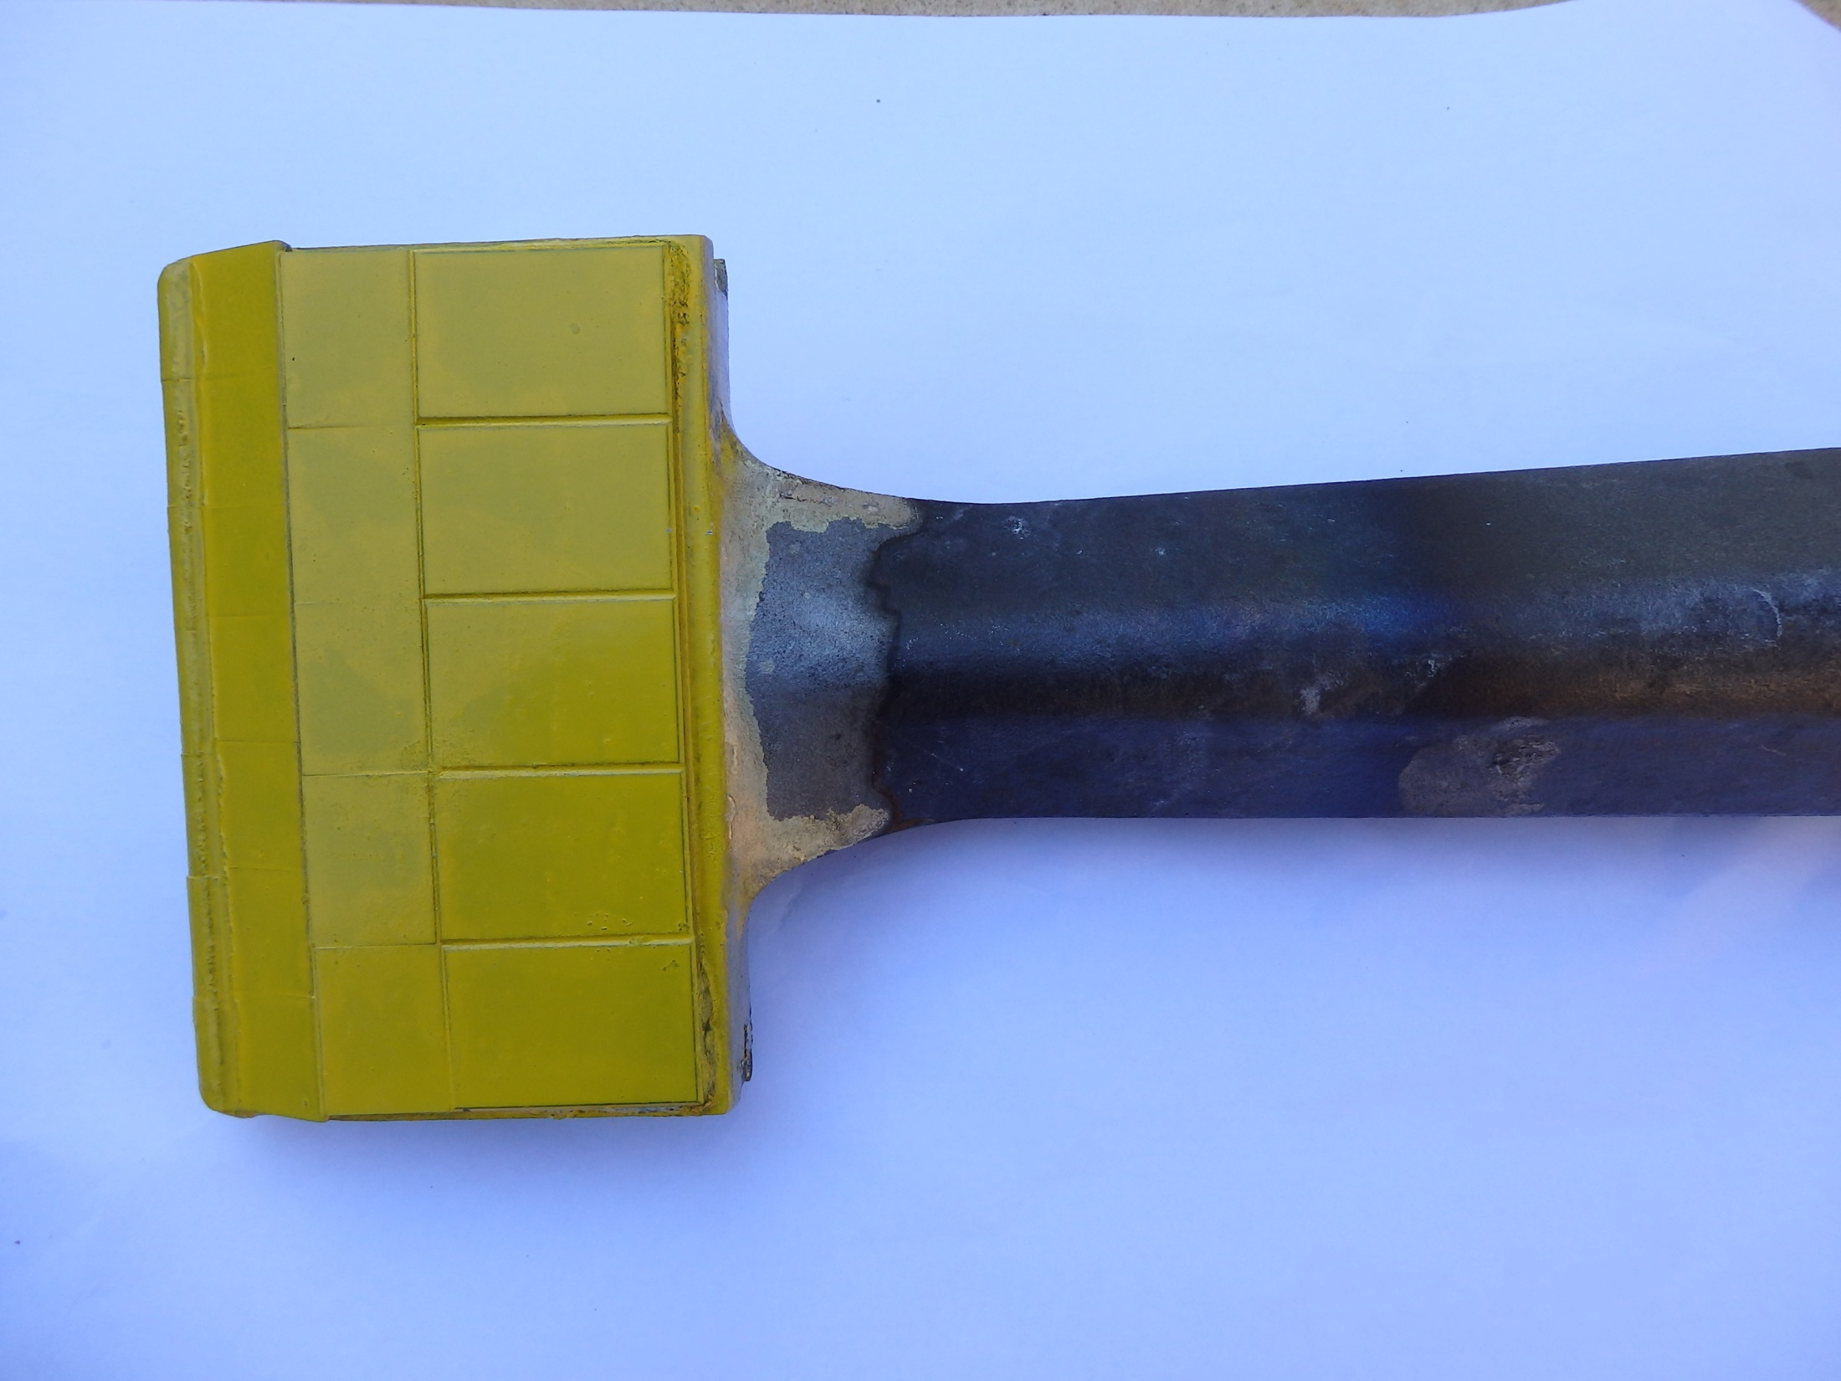
New Tyne – no wear

Slide 30
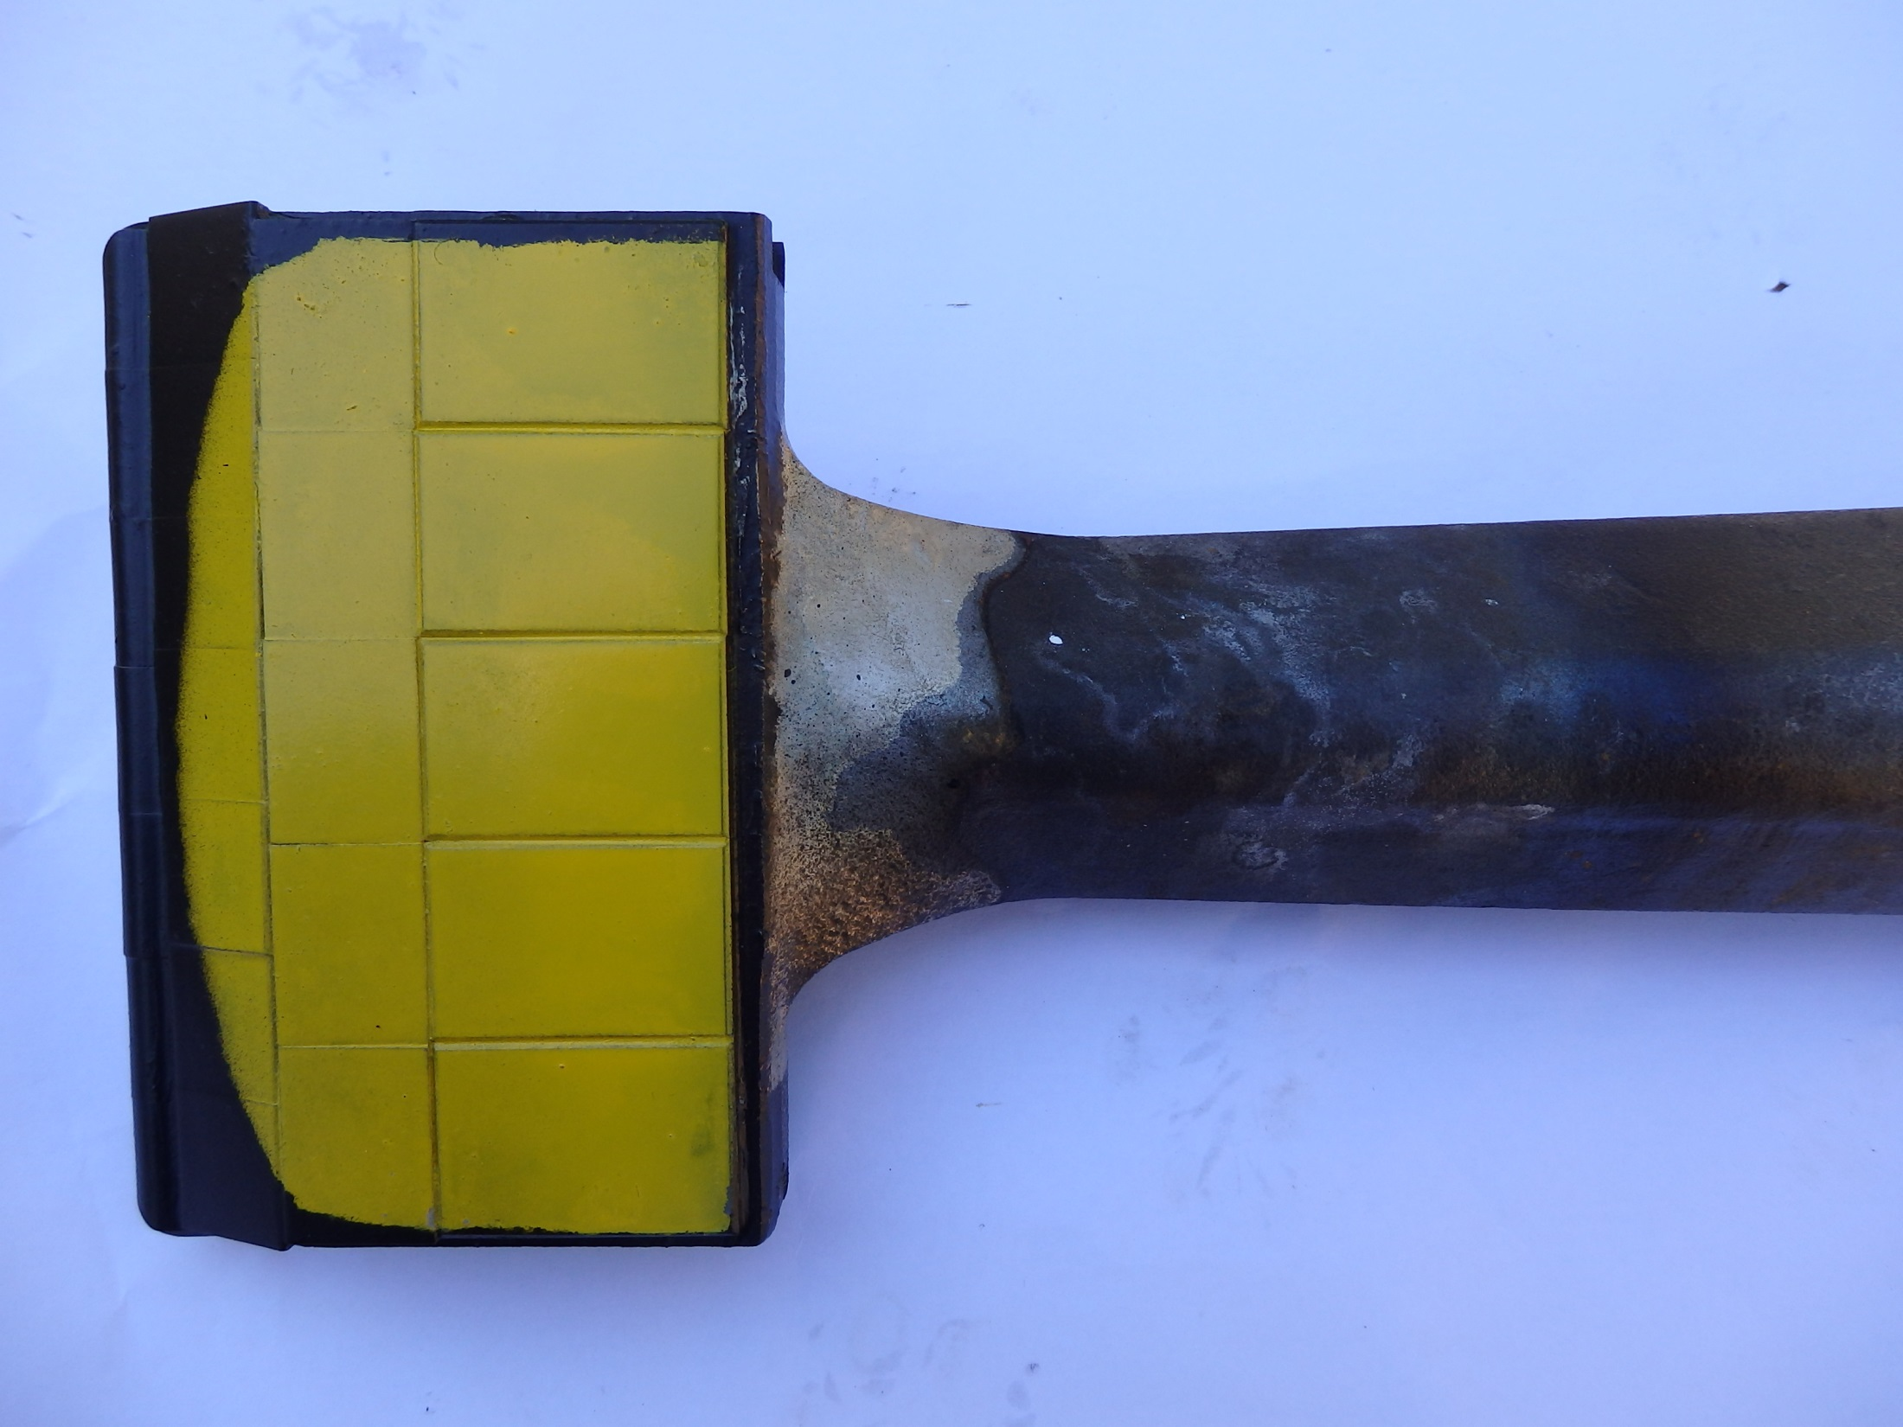
Tyne indicating 25% wear

Slide 31
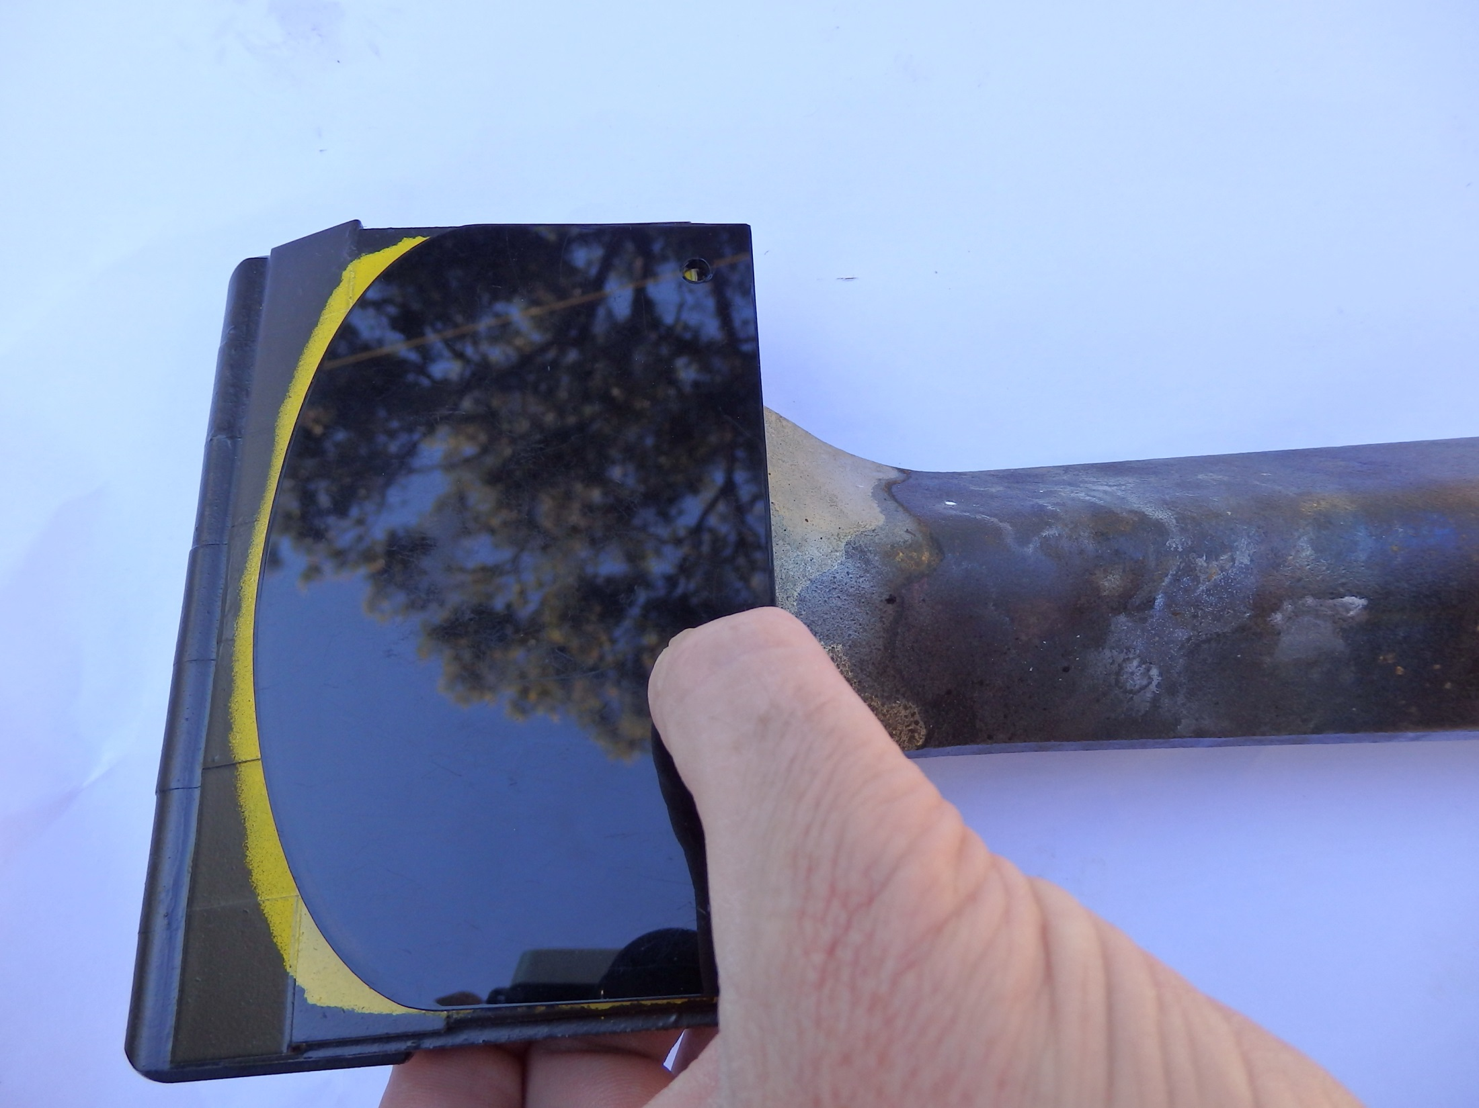
Wear Indicator Gauge

Slide 32
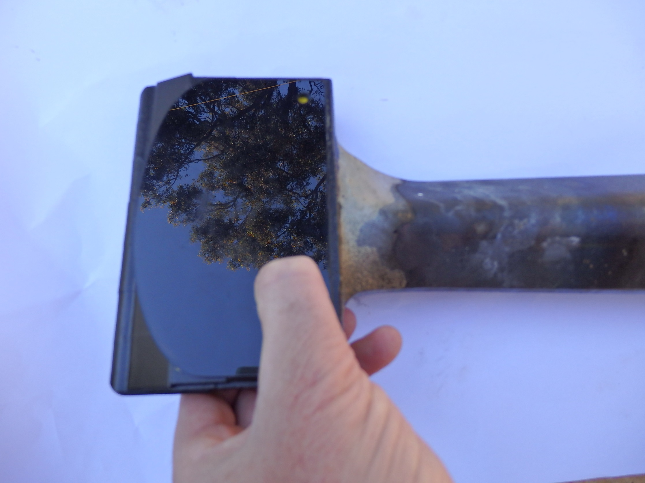
Wear Indicator Gauge – condemnation point- exceeds 25% wear

Slide 33
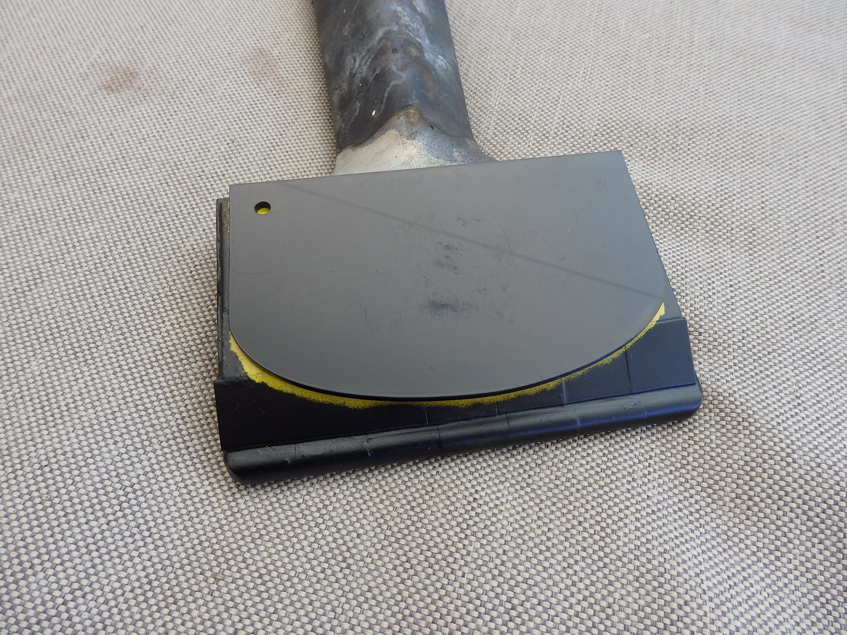
Wear Indicator Gauge – condemnation point- exceeds 25% wear

Slide 34
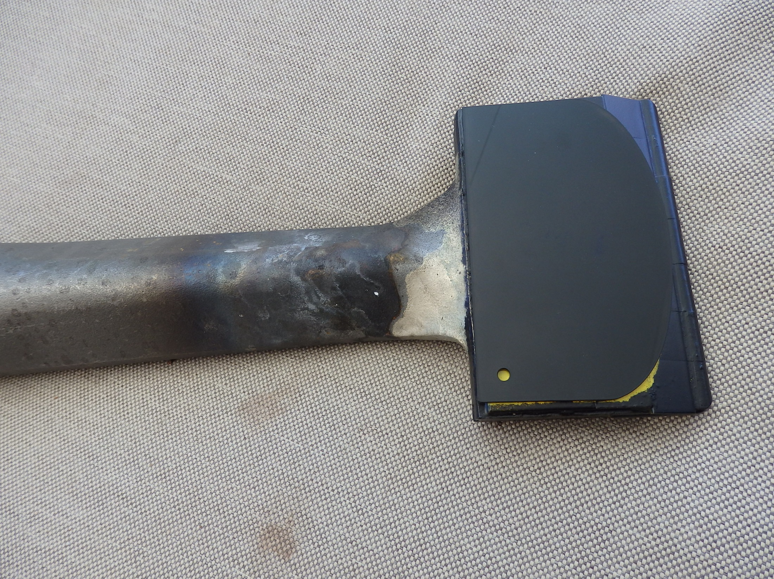
Wear Gauge – Condemnation point

Slide 35
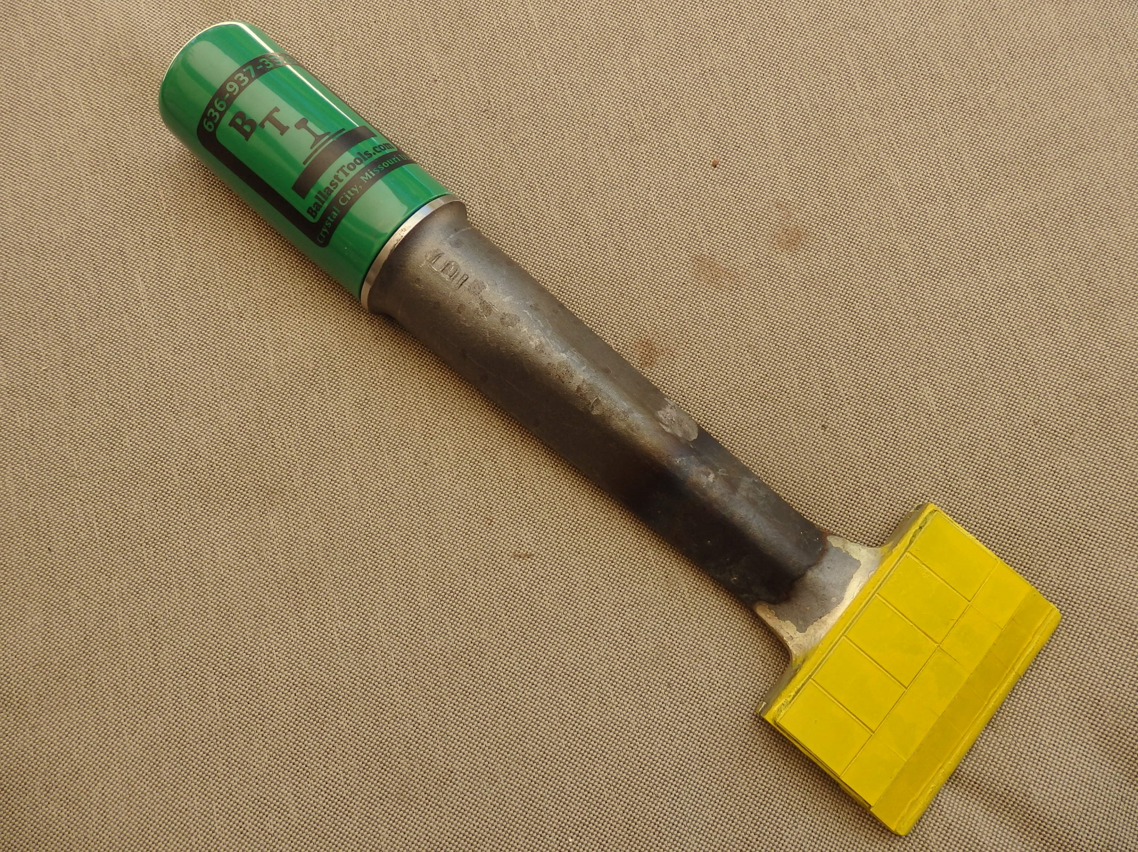
Protective Sleeve

Slide 36
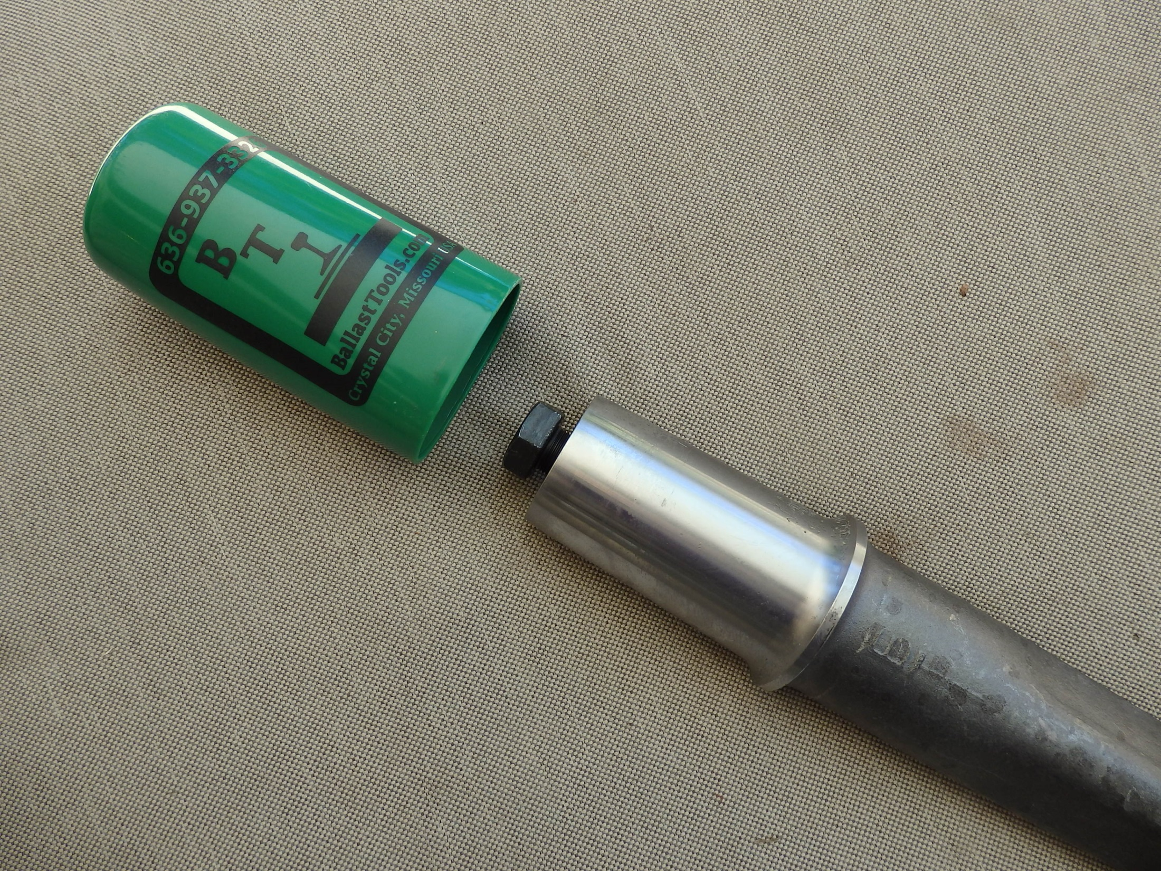
Protective Sleeve

Slide 37
Locating the BTI Tyne for your Machine
Key Source Rail have developed a “Tamping Tyne Converter” that references the OEM tyne (Plasser, Harsco Jackson, Matisa) and gives you the replacement BTI Tyne.

Slide 38
The Key Source Rail OEM Converter

Slide 39
BTI Tamping TYNE Removal Tool
BTI have developed a unique tyne removal tool. BTI are the only manufacturer of this tool.
The Tyne Removal Tool saves time and money on changing out used tynes and enhances safety performance.

Slide 40
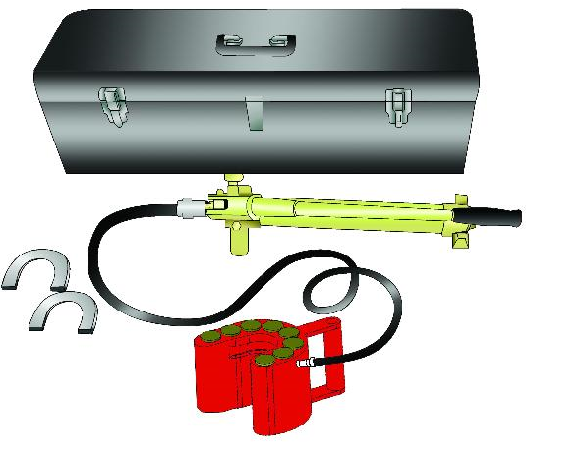
THE BTI TAMPING TYNE REMOVAL TOOL
No more wedges, sledge hammers and brute strength required

Slide 41
BTI Tamping Tyne Removal Tool
The horse shoe collar design allows for simple “one person” operation to safely remove tynes . This has resulted in significant reduction in finger and back (soft tissue) injury

Slide 42
THE BTI TAMPING TYNE REMOVAL TOOL
The jacking cylinders ensure even removal pressure for ease of removal and operator safety

Slide 43
THE BTI TAMPING TYNE REMOVAL TOOL
The BTI tyne has a specifically designed “jacking collar” to enable ease of removal using the tyne Removal Tool. This collar is unique to BTI tynes.

Slide 44
BTI Broken Tyne Removal Tool
Broken tynes can take hours to remove and often oxy acetylene must be used to remove the tool
Because of this BTI developed the broken tyne removal tool
This tool is the fastest, safest , most time efficient and economical way to remove a tyne that has snapped in the machine

Slide 45
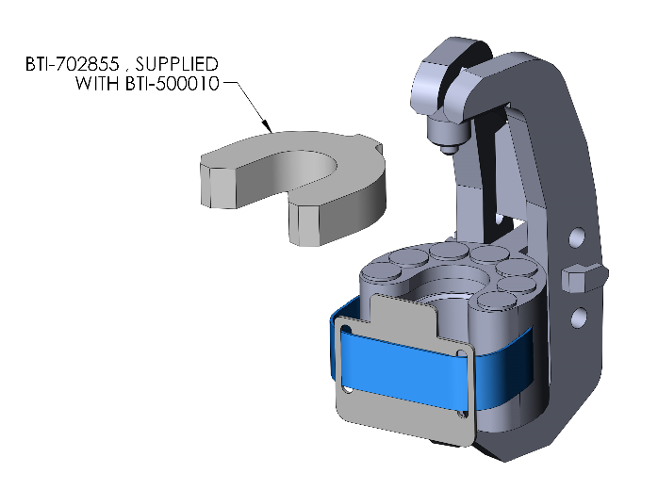
THE BTI BROKEN TYNE REMOVAL TOOL

Slide 46
KEY SOURCE RAIL WRAP UP
Key Source Rail supports the BTI product
We offer education and training in tyne wear and removal
Key Source Rail offers a tyne that we believe has a longer life and we know costs less than the OEM tynes

Slide 47
KEY SOURCE RAIL WRAP UP
WHAT ELSE DOES KEY SOURCE RAIL OFFER:
KSR are not just selling a tyne, we offer –
Education and awareness,
Support for all your rail needs,
Sharing product knowledge and innovation,
Training for your people
All of this at no cost to you
Ballast regulator wear plates and undercutter wear parts are another area that your business will benefit from sourcing from Key Source Rail

Slide 48
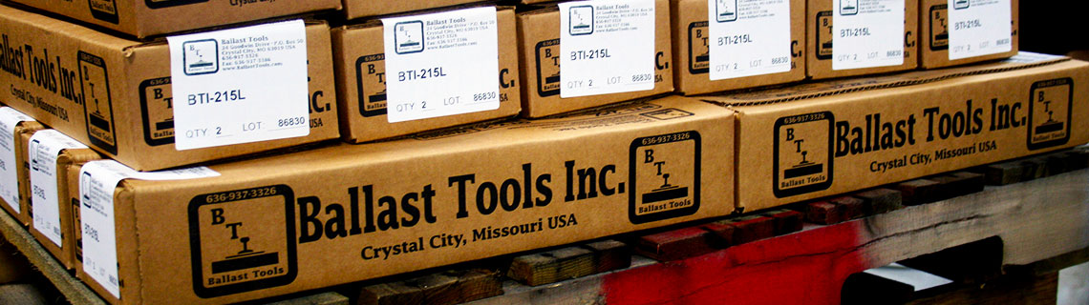
Contact the Tamping Tyne Specialist for tynes and all your rail network parts and training:
KEY SOURCE RAIL
Perth Office Support (08) 9237 8500
East Coast Support (02) 6762 7900
OR
sales@keysourcerail.com.au

Slide 49
Thank You
How else can we help you with your rail issues, training and parts and equipment sourcing?

